Slide 1


ENHANCED WDN HYDRAULIC MODELLING
WDNetXL vs. EPANET
Orazio Giustolisi (orazio.giustolisi@poliba.it)
Antonietta Simone (antonietta.simone@poliba.it)
Luigi Berardi (luigi.berardi@unich.it)
Daniele Laucelli (daniele.laucelli@poliba.it)

Slide 2



Slide 3
Aims and scopes
Innovation Decision Environment Awareness
Transfer technology and innovative tools
for analysis and decision support
from research to complex systems in civil engineering
to raise awareness of management decisions in terms of
effectiveness, efficiency and sustainability.

Slide 4
Main activities
Scientific and technical advice for the analysis and decision support in civil engineering through innovative tools developed by the company, also integrated with other systems
Training of users in developing and using innovative tools by organizing workshops, webinars and conferences oriented to researchers’ training or professional training;
Customized solutions and training of professionals on advanced tools for data analysis and decision support systems in civil engineering
orazio.giustolisi@poliba.it
rita.ugarelli@sintef.no
vincenzo.simeone@poliba.it
brunone@unipg.it
http://www.hydroinformatics.it/IDEA-RT/

Slide 5

WHY and WHERE
ENHANCED HYDRAULIC MODELLING

Slide 6
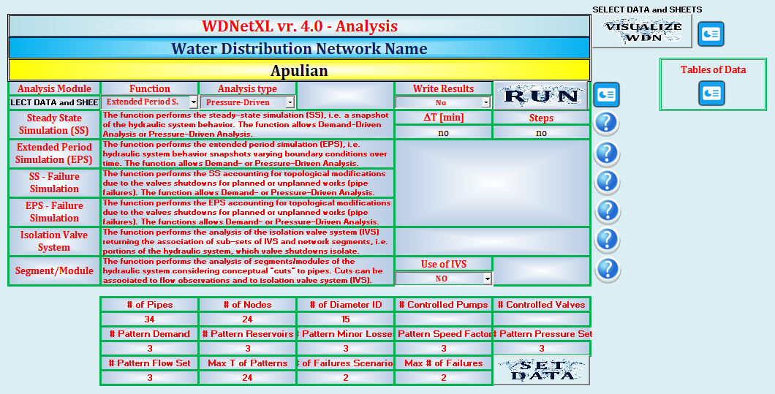
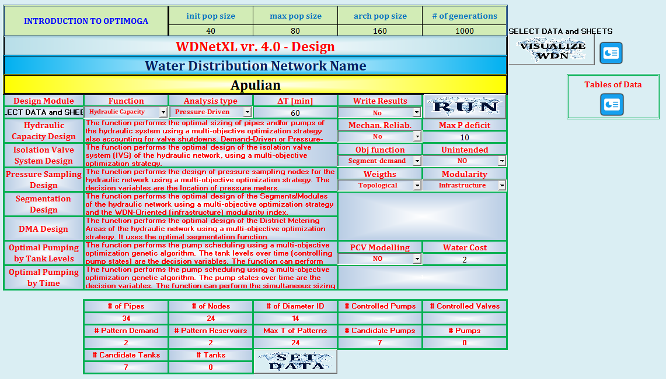
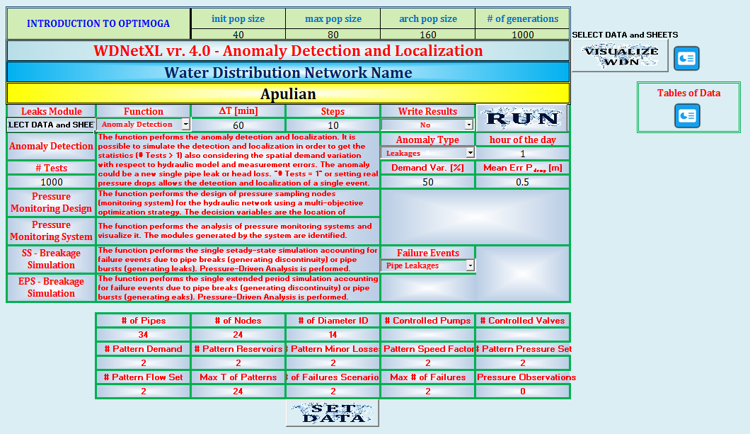

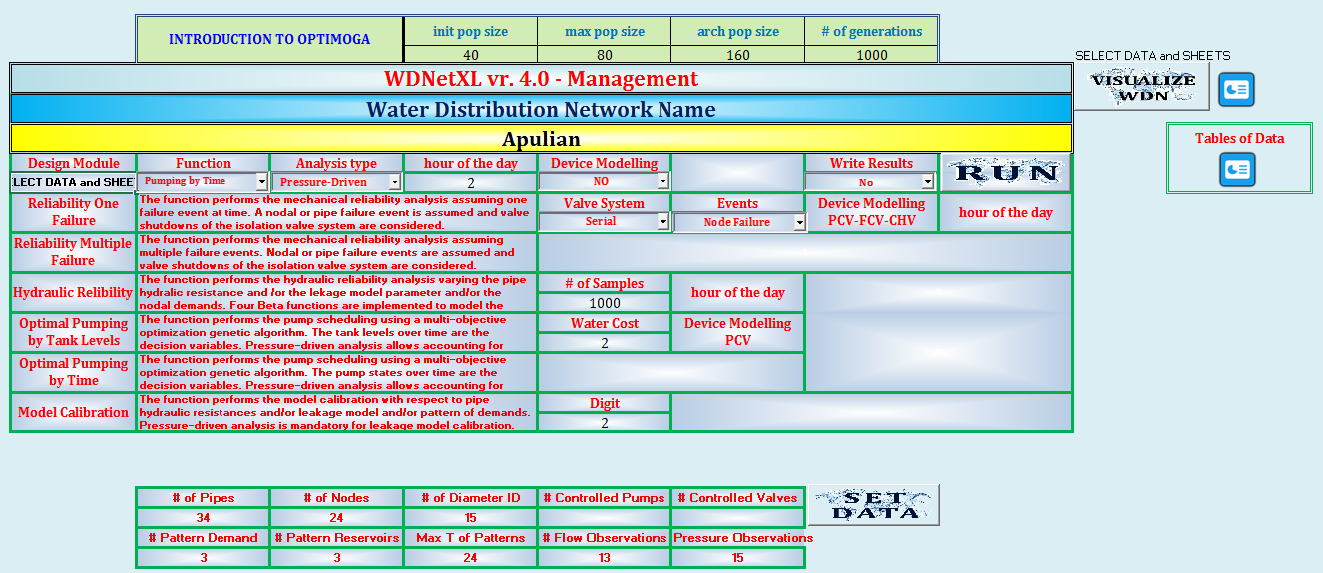
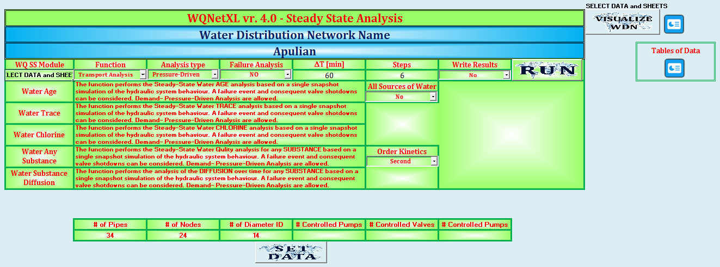
WDNetXL framework
ANALYSIS
PLANNING
LEAKAGE CONTROL
MANAGEMENT
WATER QUALITY
PRESSURE CONTROL

Slide 7
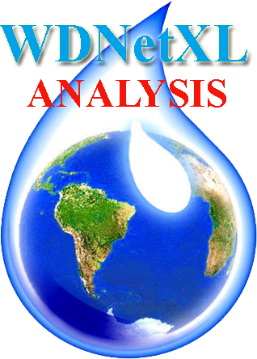
WDNetXL framework
WDNetXL_Analysis Module
It performs several hydraulic and topologic analyses of the WDN considering any device and both Pressure Driven Analysis and Demand Driven Analysis. It performs the single steady state simulation and the extended period simulation also considering valve shutdowns due to planned or unplanned works. .

Slide 8

WDNetXL framework
WDNetXL Planning/Design Module
It performs the optimal sizing of WDN elements (pipes, tanks, pump stations, valves) considering different aspects (reliability, cost savings, energy savings, etc.) and optimal WDN segmentation and sampling designs considering several modularity weighted metrics. It performs also optimal district metering areas and isolation valve system designs. Finally, it performs pump scheduling while sizing.
.

Slide 9
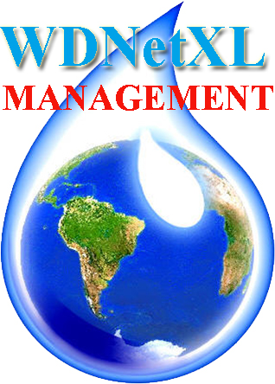
WDNetXL framework
WDNetXL Management Module
WDN management aspects can be also analyzed, as hydraulic and mechanical reliability, vulnerability to multiple failures and optimal pump scheduling. Model calibration can be performed considering also background leakages.

Slide 10
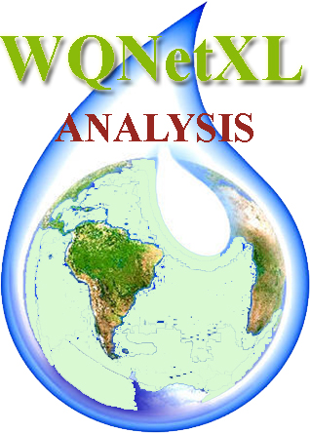
WDNetXL framework
WQNetXL (Water Quality analysis)
WDN water quality aspects can be analyzed considering different perspectives (water age, water trace, contaminant, etc.), assuming the presence of all possible devices and varying topology.

Slide 11
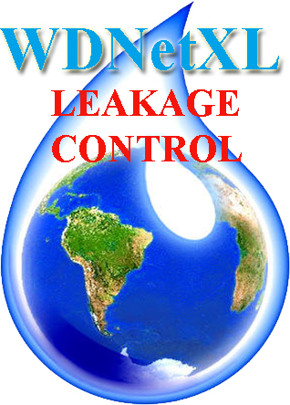
WDNetXL framework
WDNetXL Leakage Control Module
It performs the optimal pressure sampling design using the modularity index approach and the anomaly detection and localization by means of pressure drops in the WDN. The Anomalies could be burst leaks of head losses. It performs also the statistics of the localization for a given network of pressure sensors.

Slide 12
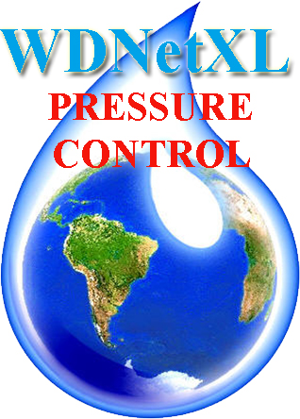
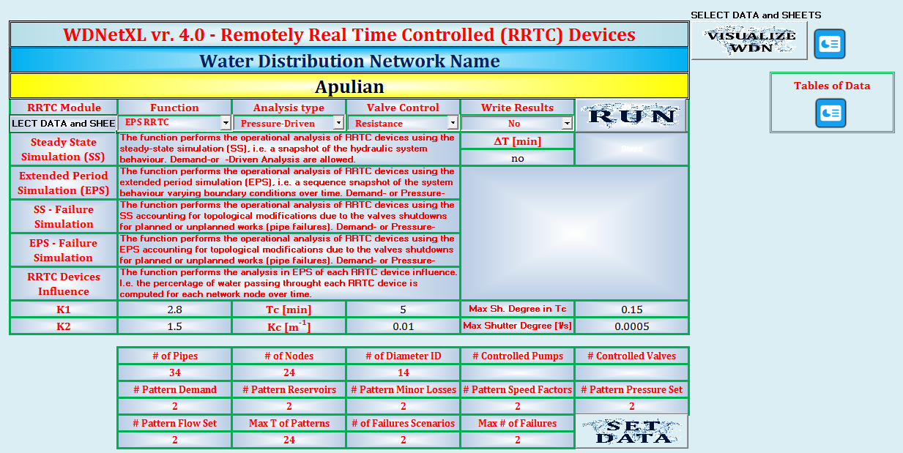
WDNetXL framework
WDNetXL_Pressure Control Module
Analysis of operational schemes for pressure control via Remotely Real-Time Controlled (RRTC) Pressure Control Valves, aimed at reducing background leakages via pressure control, under both normal and abnormal conditions.

Slide 13
EPANET
(and EPANET-based softwares)
ENHANCED HYDRAULIC MODELLING
for WDN MANAGEMENT PURPOSES
Main features to compare
Hydraulic and topological analyses
Representation of demand-pressure relations
(i.e. Demand-Driven Analysis vs. Pressure Driven Analysis)
Leakages: bursts and background
Integration of topological analysis within the hydraulic simulation (normal and abnormal functioning)
Simulation of pressure control scenarios
Simulation of Pressure control strategies using Pressure Control Valves or Variable Speed Pumps
vs.
WDNetXL

Slide 14
EPANET
(and EPANET-based softwares)
Hydraulic and topological
analyses
vs.
WDNetXL
Demand-driven analysis
Demand-driven analysis
Pressure-driven analysis

Slide 15
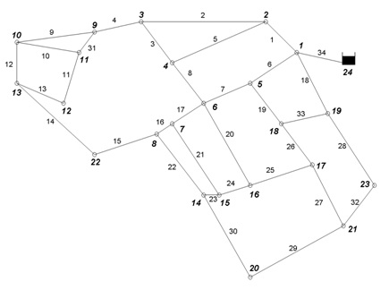

Pressure-driven analysis
Normal Functionng
Demand-driven analysis (EPANET)
Pressure-driven analysis

Slide 16
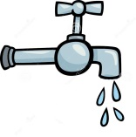
Analisi pressure-driven
Abnormal Functioning
Demand-driven analysis (EPANET)
Pressure-driven analysis

Slide 17
EPANET
(and EPANET-based softwares)
Hydraulic and topological
analyses
vs.
WDNetXL
Demand-driven analysis
Demand-driven analysis
Pressure-driven analysis
Representation of leakages as free orifices (hydrants) at node
Representation of:
  Bursts leakages as free orifices at node
  Background and unreported leakages distributed along pipes

Slide 18
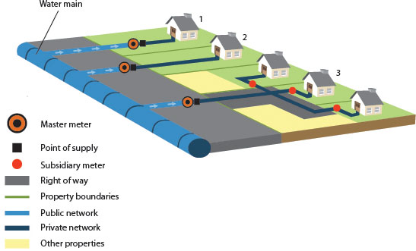

Background Leakages
Background leakages distributed through the network

Slide 19
Background leakages
P_{i}
P_{k}
P_{j}
Node i
Node j
q_{i-leak}
q_{j-leak}

Slide 20
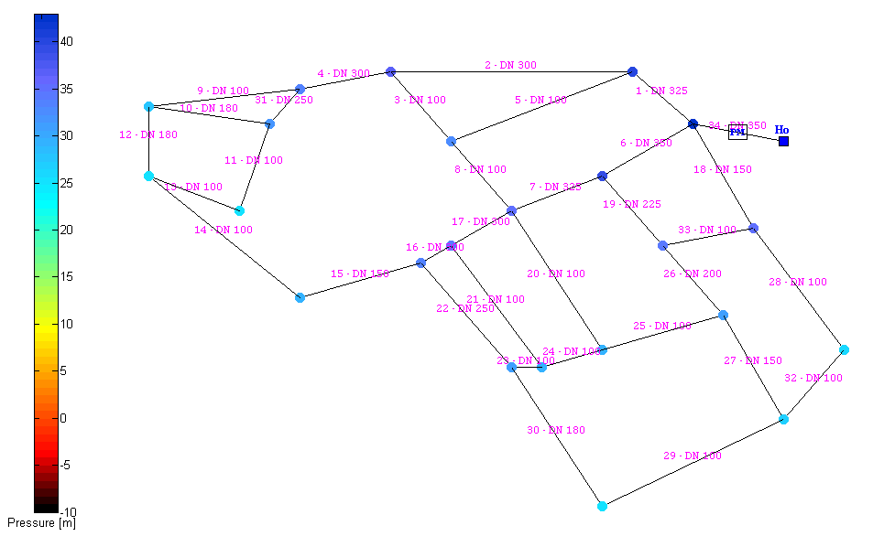
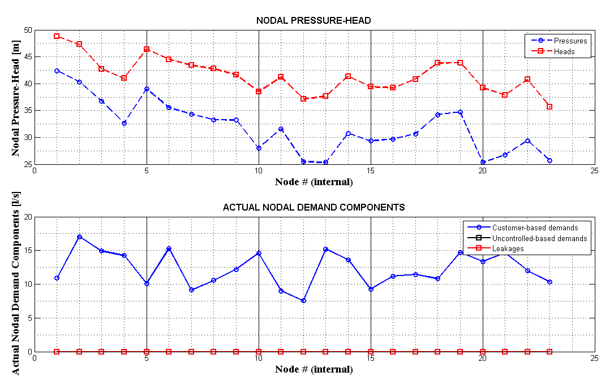
Background leakages
No background leakages

Slide 21
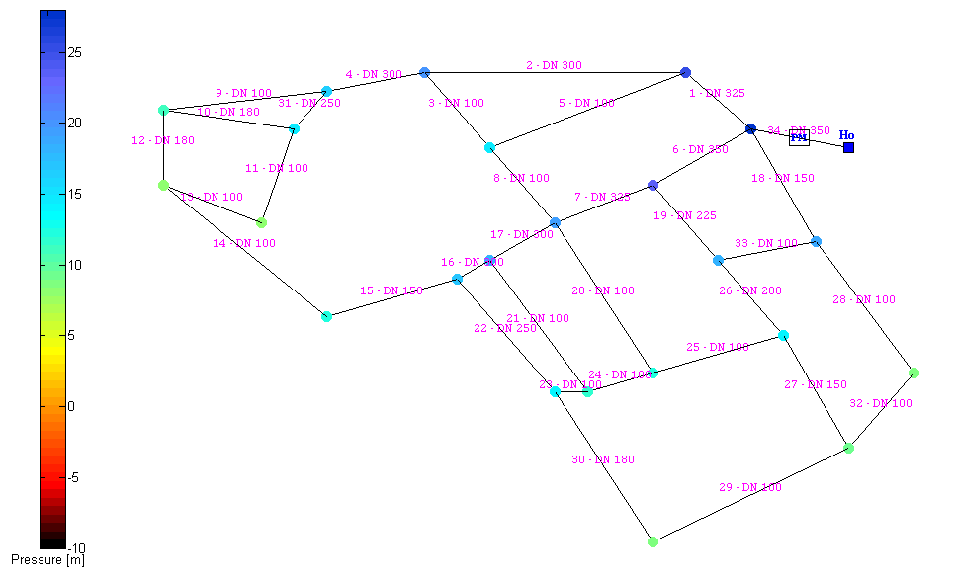
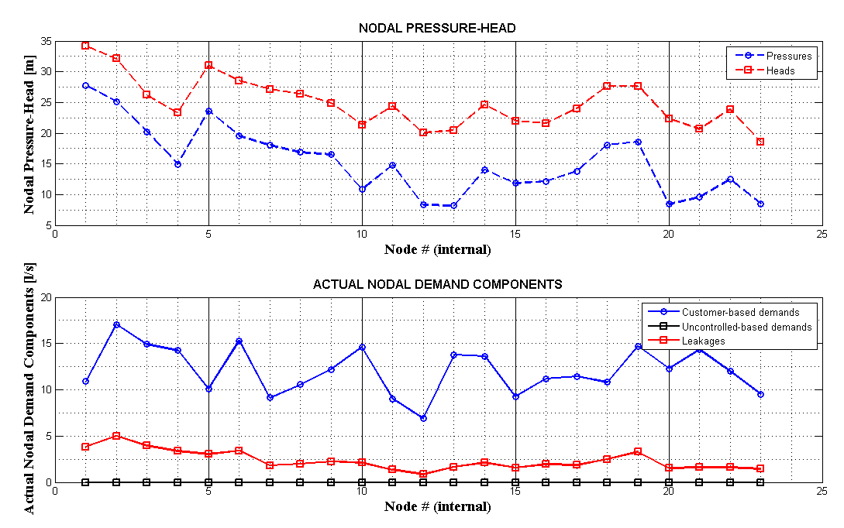
Background leakages
With background leakages

Slide 22
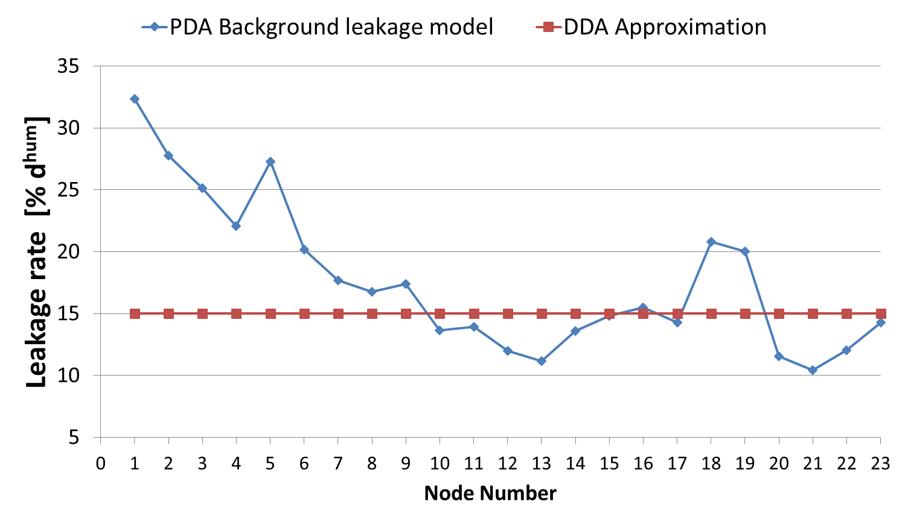
PDA vs. DDA
Background Leakages

Slide 23
Outflow: Customer and Background components of Demand
Total Outflow
Pressure-Driven Analysis
Demand-Driven Analysis
Constant «statistical» demand when the customers control the taps (i.e. sufficient residual pressure)
Pressure-Driven Analysis
Torricelli Law when taps are fully opened
Pressure-Driven Analysis

Slide 24
EPANET
(and EPANET-based softwares)
Hydraulic and topological
analyses
vs.
WDNetXL
Demand-driven analysis
Demand-driven analysis
Pressure-driven analysis
Representation of leakages as free orifices (hydrants) at node
Representation of:
  Bursts leakages as free orifices at node
  Background and unreported leakages distributed along pipes
No other “customized” types of water demand
Multi-floor buildings
Private «in-line» tanks

Slide 25
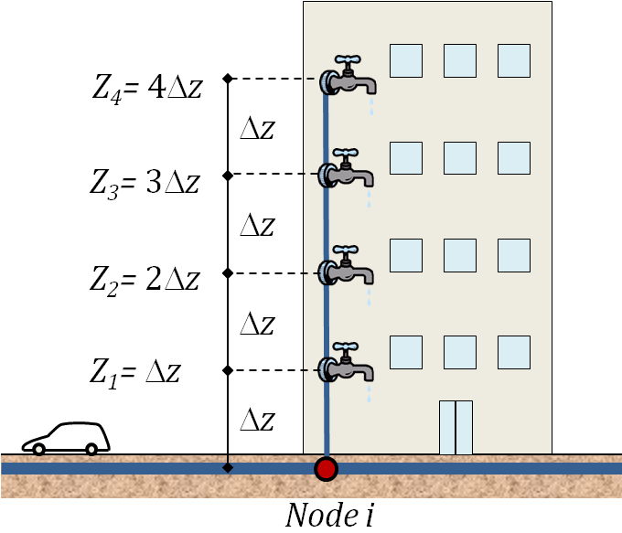

Multi-floor buildings
H₀
H

Slide 26
EPANET
(and EPANET-based softwares)
Hydraulic and topological
analyses
vs.
WDNetXL
Demand-driven analysis
Demand-driven analysis
Pressure-driven analysis
Representation of leakages as free orifices (hydrants) at node
Representation of:
  Bursts leakages as free orifices at node
  Background and unreported leakages distributed along pipes
No other “customized” types of water demand
Multi-floor buildings
Private «in-line» tanks
No topological analysis integrated in the hydraulic model
Topological analysis integrated in the hydraulic model

Slide 27
Private local water storages

Slide 28
Private local water storages
LOCAL STORAGES IN THE MODEL
NO LOCAL STORAGES IN THE MODEL

Slide 29
EPANET
(and EPANET-based softwares)
Hydraulic and topological
analyses
vs.
WDNetXL
Demand-driven analysis
Demand-driven analysis
Pressure-driven analysis
Representation of leakages as free orifices (hydrants) at node
Representation of:
  Bursts leakages as free orifices at node
  Background and unreported leakages distributed along pipes
No other “customized” types of water demand
Multi-floor buildings
Private «in-line» tanks
No topological analysis integrated in the hydraulic model
Topological analysis integrated in the hydraulic model

Slide 30
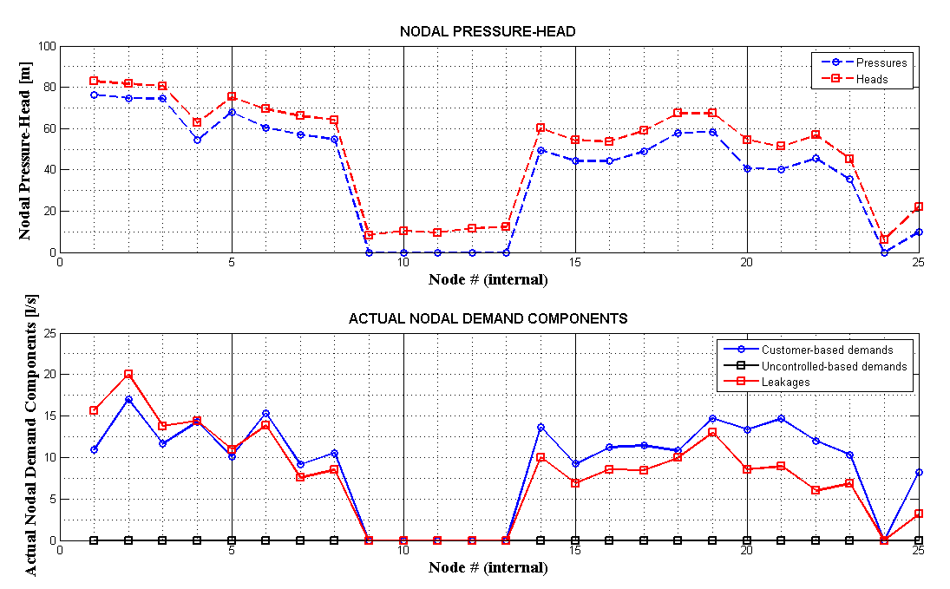
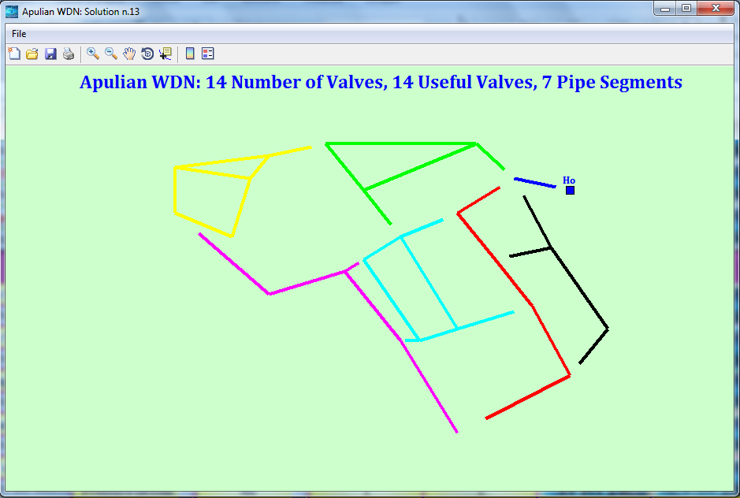
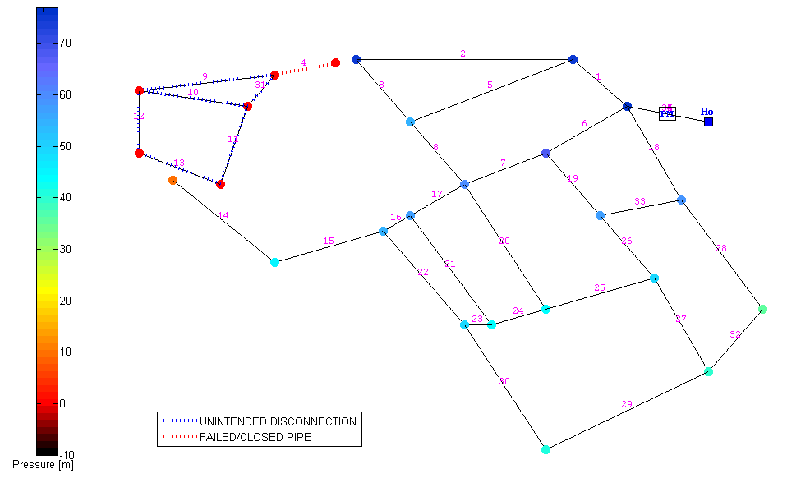
Analysis under variable topology

Slide 31
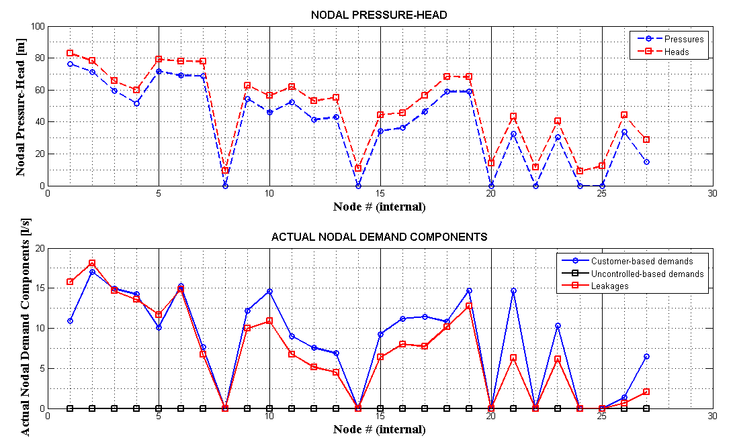
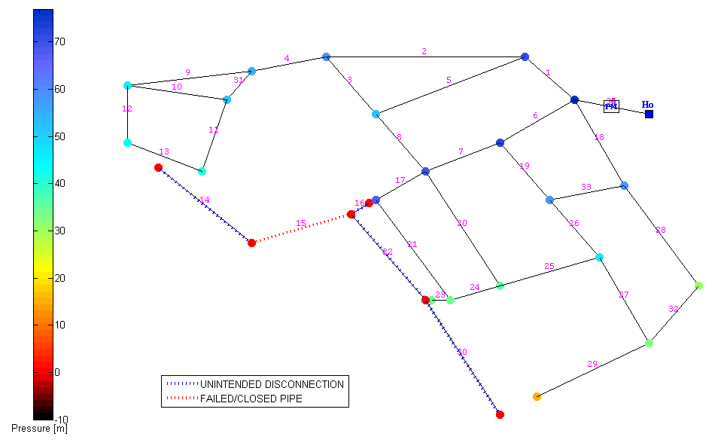
Analysis under variable topology

Slide 32
Analysis of
Isolation Valve System
Isolation Valve System
V1, V2, V3, V4, V5, V6
V
6
8
1
2
3
1
2
2
V
1
V
3
V
6
7
3
5
V
5
4
4
5
V
4
6

Slide 33
Analysis of
Isolation Valve System

Slide 34
Analysis of
Isolation Valve System

Slide 35
EPANET
(and EPANET-based softwares)
Simulation of
pressure control scenarios
vs.
WDNetXL
Simulation of PCVs controlled locally
(by upstream/downstream node)
Simulation of PCVs controlled also by:
upstream/downstream node
remote set points (RRTC)
Analysis can simulate various strategies to drive the electric modulation of valves in Remote Real Time Control (RRTC) with Programmable Logical Control units

Slide 36
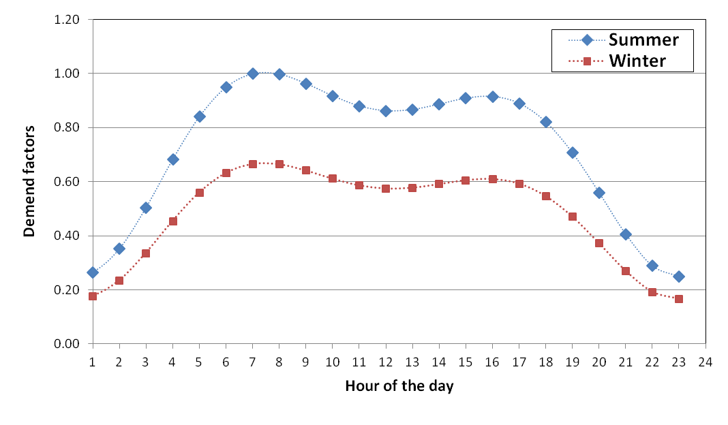
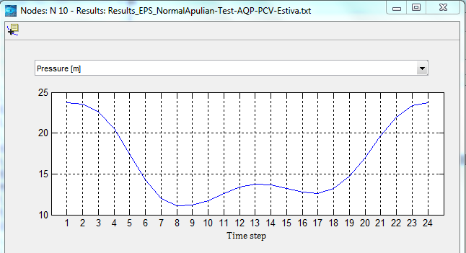
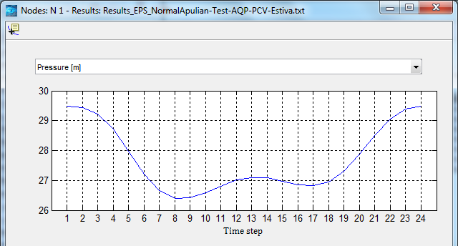
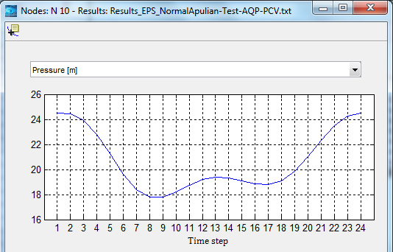
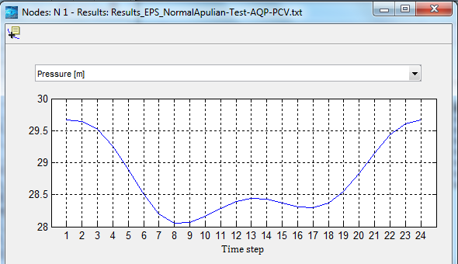
Remotely controlled devices
Node 10
Node 1
Node 10
Node 1
Summer
Winter

Slide 37
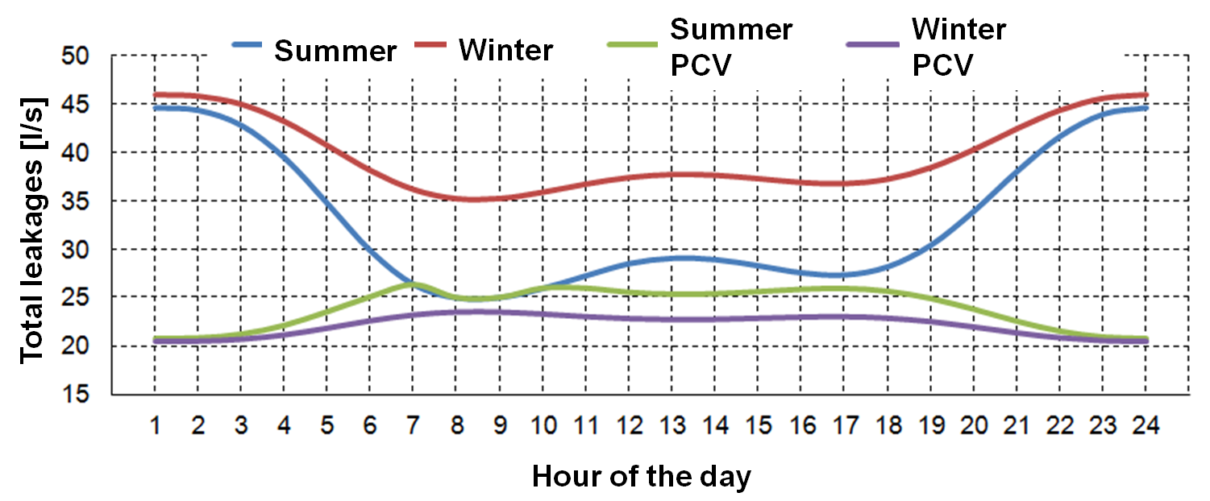
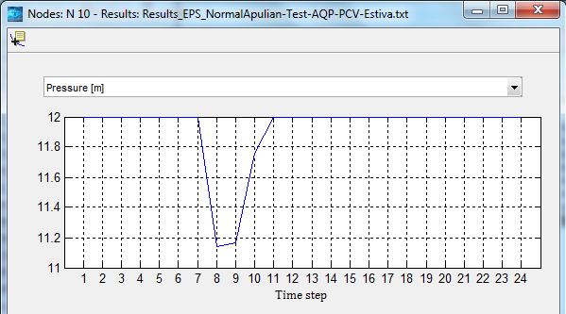
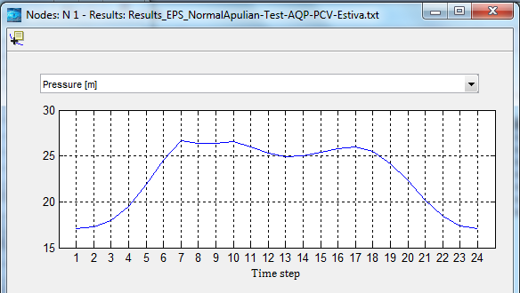
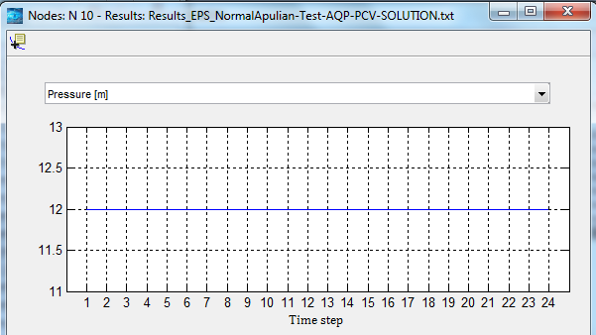
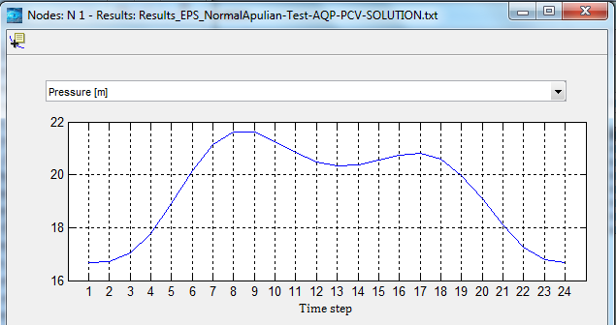
Remotely controlled devices
Node 10
Node 1
Node 10
Node 1
Summer
Winter

Slide 38
Remote Real Time Control of pressure reduction Valves and Pressure control

Slide 39
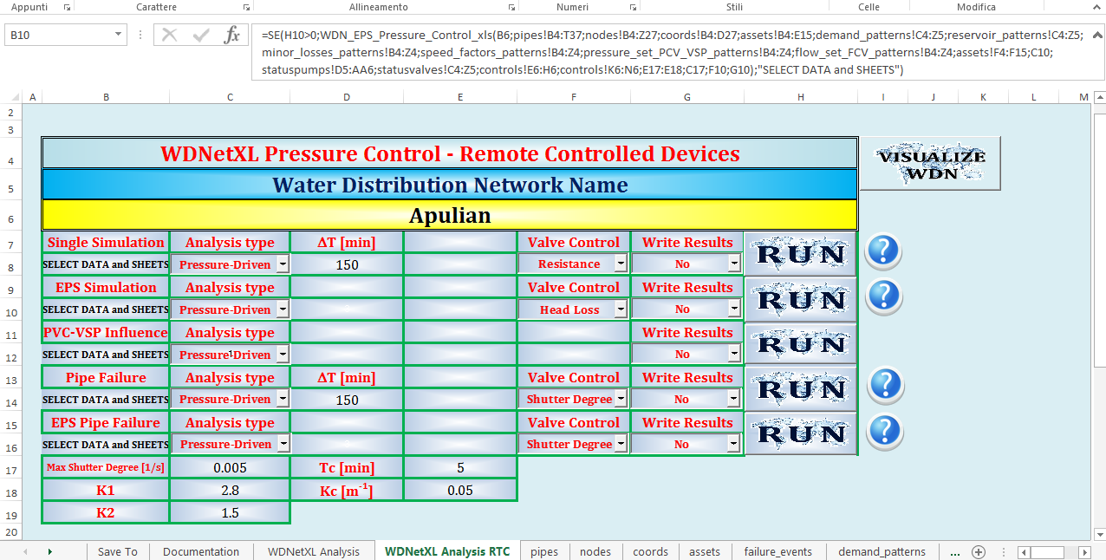
Pressure Control Module
Notes:
OK

Slide 40
Planning
assume instantaneous achieving of pressure target
Need for planning valve positions and controlling nodes which are reliable (i.e. controlling the valve in any state of the water system)
Need for closing some pipes to allow a better functioning of the valves
Need for computing the setting points
Need for assessing the background leakages reduction
Etc.
Operative
Need for simulating real-time functioning of valves
Time step for control
Strategy to control the shutter degree
Curve of the valve
Maximum shutter degree
Etc.

Slide 41
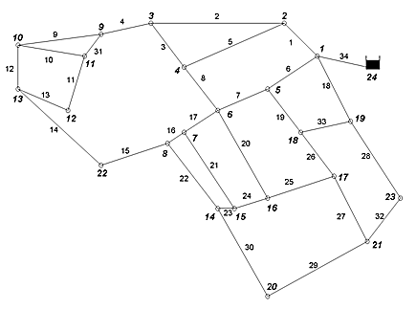
Remotely Controlled PCV vs. Classic PCV
Notes:
OK

Slide 42
Remotely Controlled PCV vs. Classic PCV
Notes:
OK

Slide 43
Remotely Controlled PCV vs. Classic PCV
Notes:
OK

Slide 44
EPANET
(and EPANET-based softwares)
Simulation of
pressure control scenarios
vs.
WDNetXL
Simulation of PCVs controlled locally
(by upstream/downstream node)
Simulation of PCVs controlled also by:
upstream/downstream node
remote set points (RRTC)
Analysis can simulate various strategies to drive the electric modulation of valvesin Remote Real Time Control (RRTC) with Programmable Logical Control units
Simulate Variable Speed Pumps (VSP) by assigning the patterns of the speed factors
Simulation of VSP:
  by assigning the patterns of the speed factors
  controlled by remote set point is available

Slide 45
Variable Speed Pumps
  Remote Real Time Control (RRTC)
Control P_{set} at remote «critical» node
P_{set} constant over time:
  Elevation
  Service requirements
  Real-time modulation of the VSP
  Increased system reliability
Pset
VSP

Slide 46
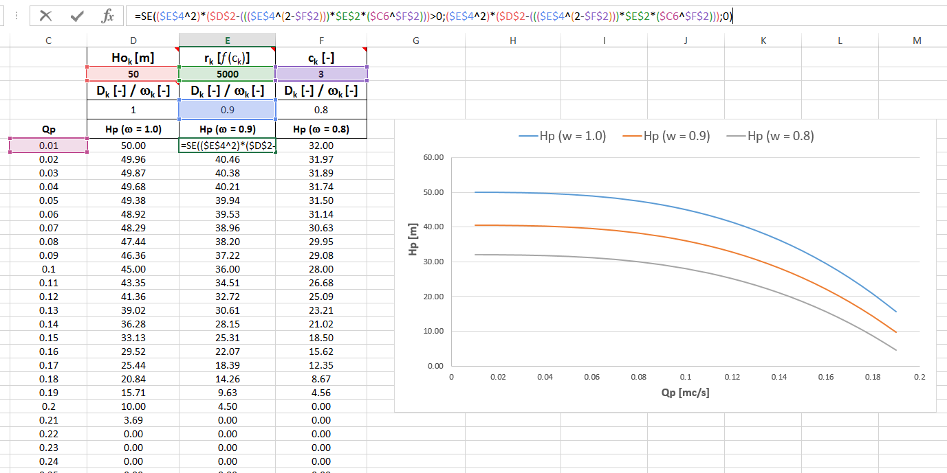
Pump Curve Equation
Variable speed factor ω

Slide 47
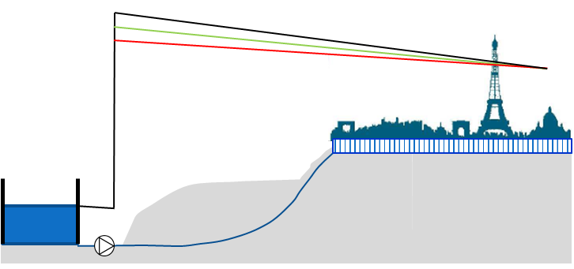
Pressure control by Variable Speed Pumps
Remore Real Time Control (RRTC)
Control at any node in the network
Control at pump outlet node
Classic (local) control
Pattern of the speed factor ω_{p}

Slide 48
Variable Speed Pumps
  Remote Real Time Control (RRTC)
Control P_{set} at remote «critical» node
P_{set} constant over time:
  Elevation
  Service requirements
  Real-time modulation of the VSP
  Increased system reliability
Pset
VSP

Slide 49
Advacements in WDN Analysis in summary
Hydraulic analysis
  Pressure-dependent customers’ water demands
  Background leakages
  Private local water storages
  Remote control of pressure reduction valves
  Remote control of variable speed pumps
  Multi-floor buildings
  Variable topology
Topological analysis
  Isolation valve system
  Network segments

Slide 50
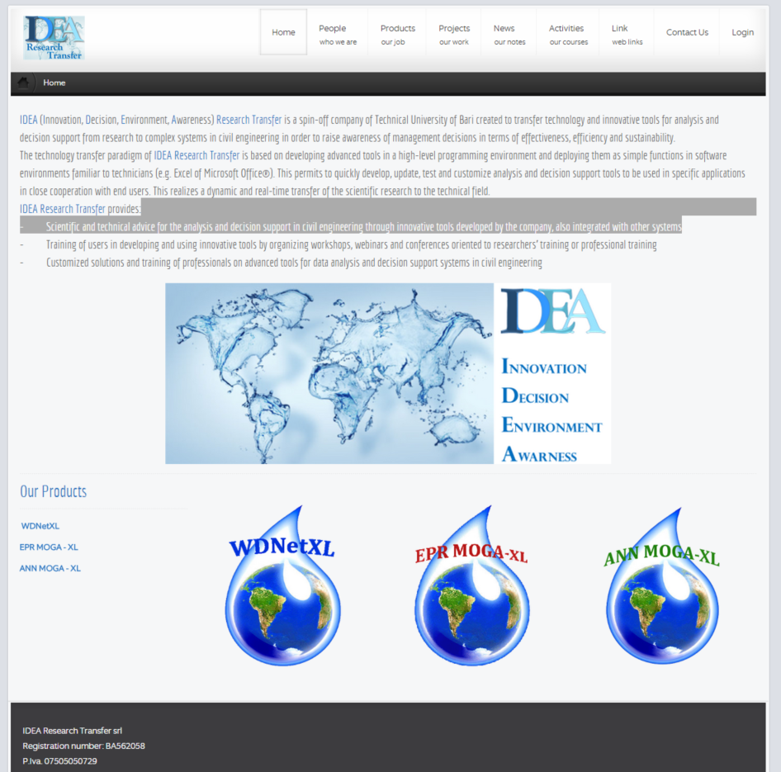
WDNetXL
Remote assistance
www.idea-rt.com

Slide 51


THANK YOU
www.idea-rt.com

